Slide 1



KultureHire Data Analysis Learnternship
UNDERSTANDING CAREER ASPIRATIONS OF GEN Z
By Shivani Mehta

Slide 2



ROADMAP
1
3
5
7
Problem Statement Documentation
Data Cleaning
Data Analysis in SQL
Dashboard in Power BI
- - - - - - - -
- - - - - - - -
- - - - - - - -
- - - - - - - -
Developed a problem statement to explore and educate about the career aspirations of Gen-Z, addressing challenges and personal insights.
The provided dataset on Gen Z's career aspirations has been cleaned and prepared for analysis, ensuring accuracy and reliability in deriving meaningful insights.
SQL is used for data analysis to extract insights from the Gen Z career aspiration dataset, enabling efficient querying, filtering, and trend identification.
A dynamic dashboard is created in Power BI to visualize and analyze Gen Z's career aspirations, providing interactive insights for better decision-making.
2
4
6
8
Data Collection
Exploratory Data Analysis
Executive Dashboard in Excel
Project Presentation
- - - - - - - -
- - - - - - - -
- - - - - - - -
- - - - - - - -
This Google Form is designed to gather questions related to Gen Z's career aspirations, exploring their goals, motivations, and expectations in the evolving job market.
The next step is Exploratory Data Analysis (EDA) to uncover patterns, trends, and insights into Gen Z's career aspirations through statistical and visual exploration.
An executive dashboard is created in Excel to visualize key insights from the Gen Z career aspiration data, enabling easy interpretation of trends and patterns
This project presentation explores the career aspirations of Gen Z, highlighting key insights, trends, and analysis derived from collected data.

Slide 3


Stage 1 :
Problem Statement
Documentation

Slide 4


What is happing ?
Why is happing ?
Current Trends and Challenges in Gen Z Career Choicesand Employment
○Gen Z is drawn to industries like technology, education, and healthcare. They prioritize socialactivism and valueworking for organizations whose ethics and values align with their own. Salary is less important than meaningful work, company practices, and social impact.
1.Importance of Understanding Gen Z CareerPreferences:
○It is essential for employers, educators, and policymakers to understand Gen Z's career aspirations to foster talent, adapt to workforce changes, and promote societal progress.
2.Why Gen Z Prioritizes Value Alignment with Employers:
○Gen Z seeks authenticity and purpose in their work, impacting employerbranding by highlighting ethics, social responsibility, and aligning with Gen Z's values to attract talent.
- - - - - - - - - - - - - - - - - - - - -

Slide 5
Where is happing ?
Who is happing ?
Where Gen Z SeeksEmployment Opportunities:
○They focus on industries such as technology, education, healthcare, and social impact sectors. They often use online platformsand social media to explorejob opportunities that offer growth and align with their values.
Key Decision-Makers Influencing Gen Z CareerChoices:
○Influences includeparents, peers, educators, influencers, and employerswho provide guidance and support throughout Gen Z's career path.
- - - - - - - - - - - - - - - - - - - - -

Slide 6
When is happing ?
When Did the Shiftin Career Expectations Occur:
○Initially focusedon salary and stability, Gen Z now prioritizes work-lifebalance, social impact, and value alignment, evolving from a growing awareness of societal issues.

Slide 7
Stage 2 :
Data Collection

Slide 8


Career Aspiration of Gen Z
Welcome! We are conducting a survey to better understand the career aspirations, preferences, and motivations of Gen Z. This survey is designed to gather insights into the types of careers that Gen Z individuals are interested in, the factors influencing their career choices, and how they envision their future work environment.
1. What is your current age?
2. How do you identify in terms of gender?
○
10 - 15
○
Male
○
16 - 20
○
Female
○
21 - 25
○
26+
3. Where do you currently reside?
4. What is the highest level of education you have completed or are currently pursuing?
○
A) Urban/City
A) High School Diploma or Equivalent
B) Suburban
○
○
○
B) Associate's Degree
○
C) Rural/Remote Area
C) Bachelor's Degree
D) I move frequently/Travel often
○
○
○
D) Master's Degree
○
E) Doctorate or PhD

Slide 9
Stage 3 :
Data Cleaning

Slide 10
Data Cleaning & Standardization:
Processed the "Career Aspiration of Gen Z" dataset by handling missing values, removing duplicates, and ensuring consistency in formatting using Excel.
Data Transformation:
Standardized categorical values, corrected data inconsistencies, and applied validation rules to improve data accuracy and usability.
- - - - - - - - - - - - - - - - - - - - -

Slide 11
Enhanced Data Quality:
Improved dataset reliability, enabling meaningful analysis and insights for understanding Gen Z career trends.

Slide 12
Stage 4 :
Exploratory Data Analysis

Slide 13
Data Summarization:
Used Pivot Tables in Excel to efficiently summarize and analyze large datasets, enabling quick insights into trends and patterns.
Dynamic Data Analysis:
Applied sorting, filtering, and grouping techniques to break down complex data, making it easier to interpret and visualize.
- - - - - - - - - - - - - - - - - - - - -

Slide 14
Interactive Reporting:
Created interactive Pivot Tables to generate real-time insights, supporting decision-making with dynamic data exploration.

Slide 15
Stage 5 :
Data Analysis in SQL

Slide 16
1. What industries are Gen-Z most interested in pursuing careers in?
2. What are the top factors influencing Gen-Z’s career choices?
Query:
Query:
SELECT
"Which of the below careers looks close to your Aspirational job ?" AS career,
COUNT(*) AS count
FROM career_aspirations_table
GROUP BY career
ORDER BY count DESC
LIMIT 10;
SELECT
"Influencing Factors",
COUNT(*) AS Factor_Count
FROM career_aspirations
GROUP BY "Influencing Factors"
ORDER BY Factor_Count DESC;
- - - - - - - - - - - - - - - - - - - - -

Slide 17
3. What is the desired work environment for Gen-Z? (e.g., remote, hybrid, in-office)
4. How do financial goals, such as salary and benefits, impact career aspirations among Gen-Z?
Query:
Query:
SELECT
"What is the most preferred working environment for you." AS Work_Environment,
COUNT(*) AS Preference_Count
FROM career_aspirations
GROUP BY Work_Environment
ORDER BY Preference_Count DESC;
SELECT
"Which of the below careers looks close to your Aspirational job?" AS Career_Aspiration,
AVG("What is your minimum expectations of salary when you are starting your career (Monthly in hand salary)") AS Avg_Starting_Salary,
AVG("For the First 3 years of your career, what is your minimum expected monthly salary in Hand?") AS Avg_Salary_After_3_Years,
AVG("After 5 years of your career from now, what is your minimum expected monthly salary in Hand?") AS Avg_Salary_After_5_Years
FROM career_aspirations
GROUP BY Career_Aspiration
ORDER BY Avg_Starting_Salary DESC;
- - - - - - - - - - - - - - - - - - - - -

Slide 18
5. What role do personal values and social impact play in career choices for Gen-Z?
Query:
SELECT
"Would you work for a company whose mission is not clearly defined and publicly posted." AS Undefined_Mission_Company,
"How likely are you to work for a company mission conflicts with its actions?" AS Conflict_Mission_Company,
"How likely are you work for a company no social impact ?" AS No_Social_Impact_Company,
COUNT(*) AS Response_Count
FROM career_aspirations
GROUP BY Undefined_Mission_Company, Conflict_Mission_Company, No_Social_Impact_Company
ORDER BY Response_Count DESC;

Slide 19
Stage 6 :
Executive Dashboard in Excel

Slide 20
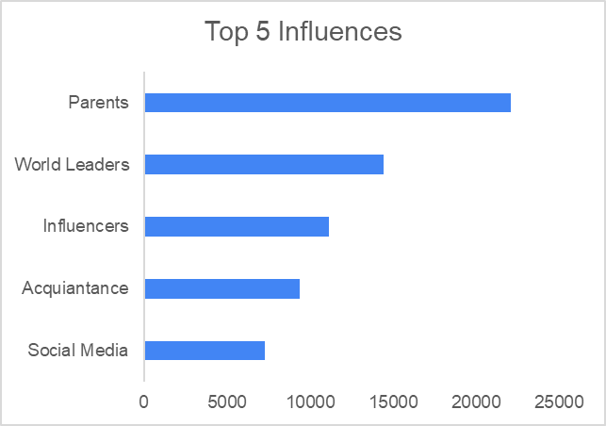
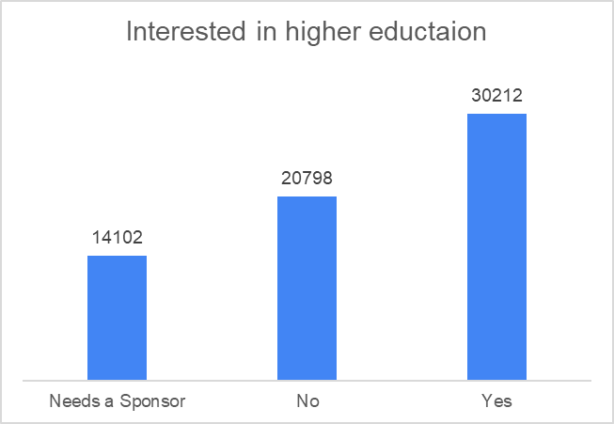
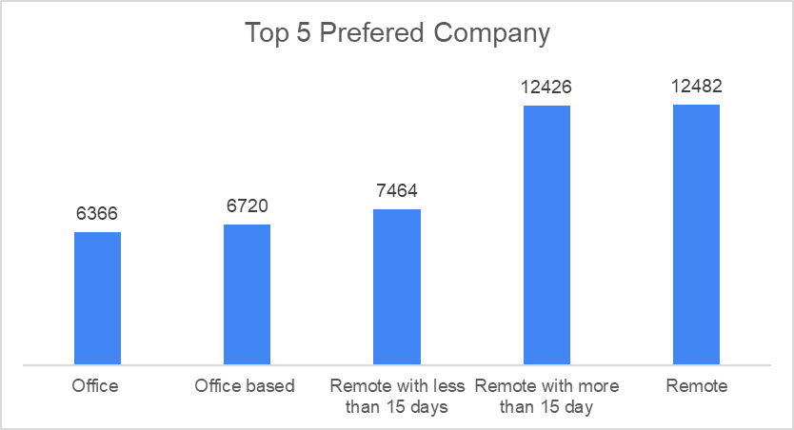

Slide 21
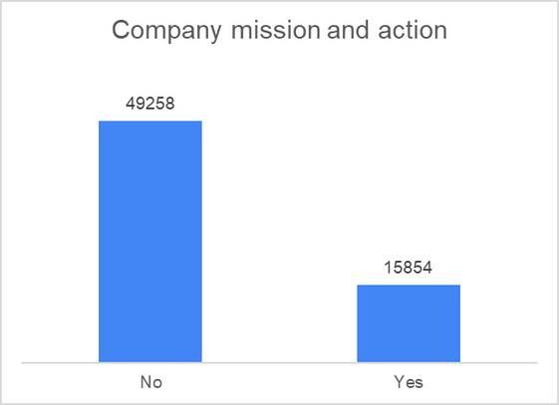
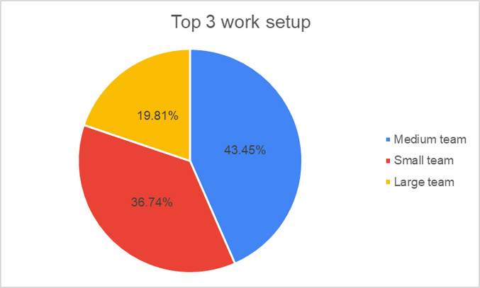
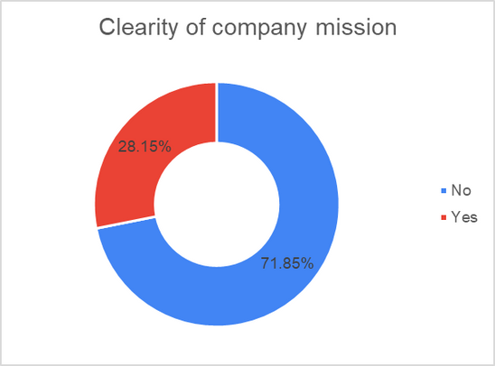
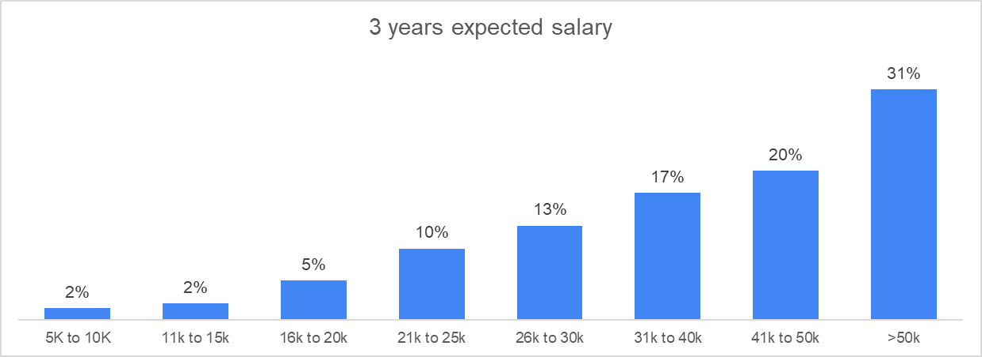

Slide 22
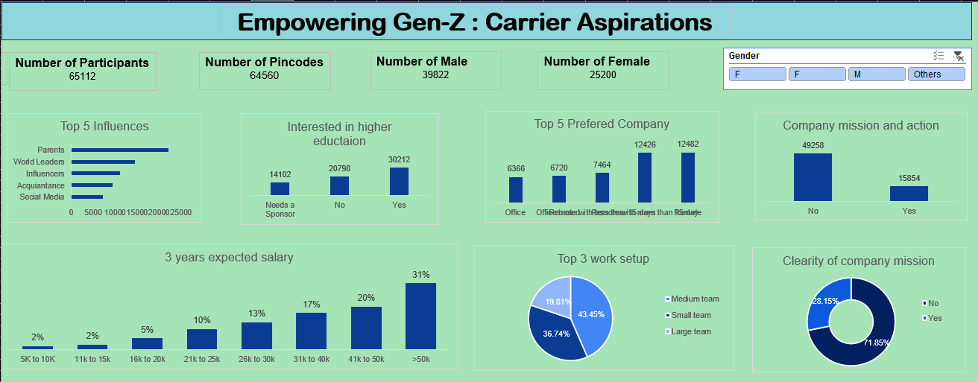

Slide 23
Stage 7 :
Dashboard in Power BI

Slide 24
INTRODUCTION
MISSION ASPIRATIONS
MANAGER ASPIRATIONS
Exploring Gen Z Work Trends :
Exploring Gen Z Managerial Dynamics :
Analyzing salary expectations, mission alignment preferences, undefined mission preferences and the impact of company missions on employee satisfaction and the impact on laid off employees.
Unveiling preferences in tenure, managerial styles, employer qualities, and team sizes for a understanding of the evolving professional landscape due to Gen Z.

Slide 25
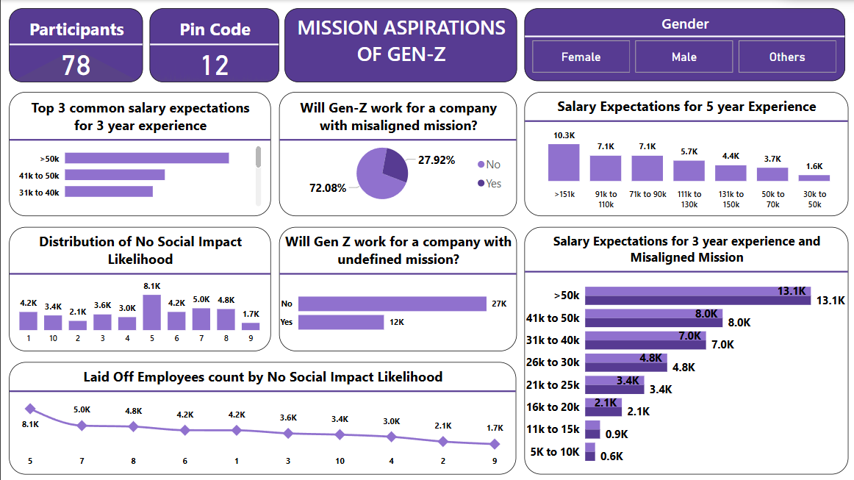

Slide 26
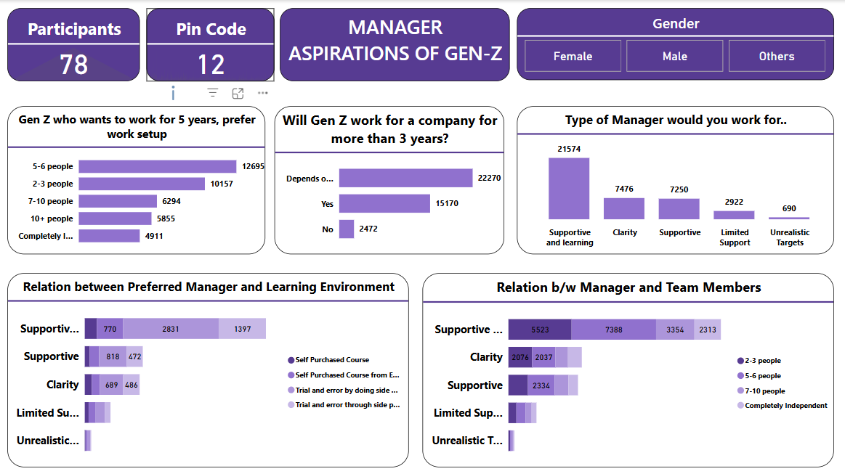

Slide 27
Stage 8:
Project Presentation

Slide 28
Project Presentation - Internship Overview
During my Data Analyst internship at Kulturehire, I gained hands-on experience in the end-to-end data analysis process. The internship covered:
Data Collection & Cleaning: Acquired skills in gathering, cleaning, and standardizing raw data to ensure accuracy and consistency.
Exploratory Data Analysis (EDA): Applied statistical techniques to uncover patterns, trends, and insights within datasets.
SQL for Data Analysis: Used SQL queries for data extraction, transformation, and manipulation to drive meaningful insights.
Executive Dashboards (Excel & Power BI): Designed interactive dashboards to visualize key metrics and support data-driven decision-making.
Final Project Presentation: Combined all learned concepts to analyze a real-world dataset and present findings through compelling storytelling and visualizations.
This internship enhanced my analytical skills, problem-solving abilities, and proficiency with industry-standard tools, preparing me for real-world data challenges.

Slide 29


